Slide 1
Career Friendly Application
Presented By Team 2:
Sherin Annie Abraham
Neha Rajgaria
Akkireddy Bharani
Brunda K
Muskan Jaiswal
Hafsa Iqmar

Slide 2
Introduction
Significance of the Application
Helps in making women understand the diverse career options they have even when constrained with a single field
Readily connects women with all the help they require to help transform into their best selves.
Empower women by providing necessary support and information to start their first career/business which will raise dignity for all within the family and help grow the society.
Written by Sherin

Slide 3
Problem Statement
Career Friendly Application:
With the help of this platform, we aim to provide free technological/career related advice/services to women in need. We want to introduce all the knowledge to start a project/business in general and specifically different fields such as content writing, management, operations, etc. The application should facilitate the method of choosing a mentor based on the user's career preferences.
Given problem statement

Slide 4
Benefit & Success Criteria
Benefits
Help to facilitate, clarify, support, and help women in knowing and understanding different career opportunities and how to get them.
Empower women by providing necessary support and information to start their first career/business which will raise dignity for all within the family and help grow the society.
Success Criteria
Free technology information for women.
Free advice through the icon: "Free career Advice".
List of Independent mentors who can help the participants to understand different career opportunities and how to achieve them.
Given problem statement

Slide 5
Solution Pitch
We propose a website that uses HTML and CSS to design the front-end and PHP and MySql to code the back-end.
The complete layout was designed using HTML and styled with CSS, after which all the pages were linked together for a smooth user interface flow.
The database was then created on XAMPP Control Panel, and linked using PHP.
The user data is stored during the registration in the tables and can be recalled for logging in.
During the login, if the username and password entered is wrong, or if the database for the username does not exist, error contingencies are in place to display the appropriate messages.
If during registration, same email is found, the page will notify the user that they are already registered.
Written by Sherin

Slide 6
Solution Pitch…
After the login page is the mentor/mentee page for registration, for which the data needs to be saved.
Then the Dashboard can be viewed where the user will be able to navigate through.
There will also be a “Free Career Advice” page developed for the users to help them with all their problems.
Written by Sherin

Slide 7
GitHub Repository Link
https://github.com/Hafsa246/Career-Friendly-Application
Created by Hafsa

Slide 8
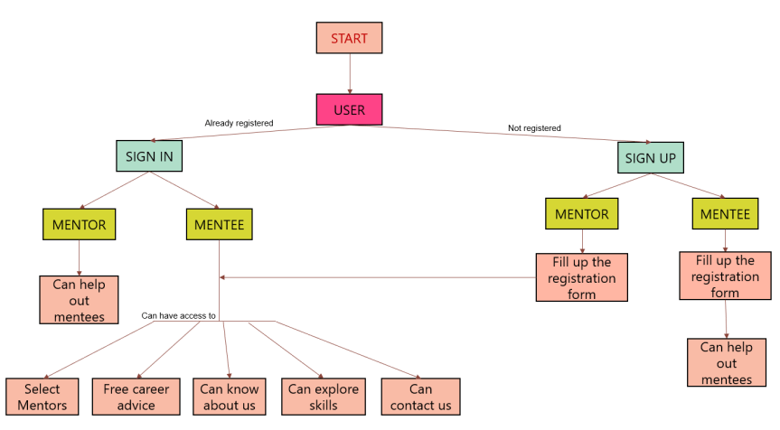
Solution Explanation
Contributed by Hafsa

Slide 9
Overview
Everyone’s individual contribution
Data compiled by Sherin

Slide 10
Sherin Annie Abraham
List of Contributions
Covered research work ( CI/CD pipeline, Continuous Integration, Continuous Delivery, Continuous Deployment, Future scope)
Completed login/signup page with backend using PHP.
Tried implementing backend with Django for the first time.
Learnt PHP and CSS to make the final login/signup page and was successful in completing both the frontend and backend for it.
Completed the making of this PPT
Member Details:
Contact no: 8109159144
Email: abrahamsherinannie@gmail.com

Slide 11
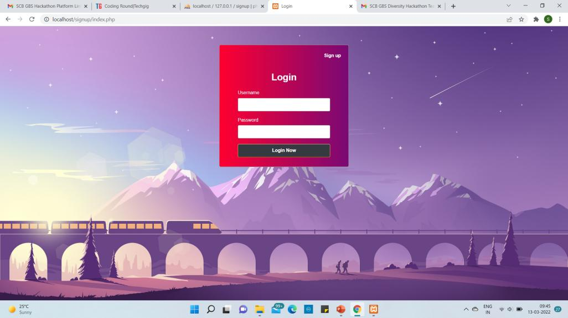
Created by Sherin

Slide 12
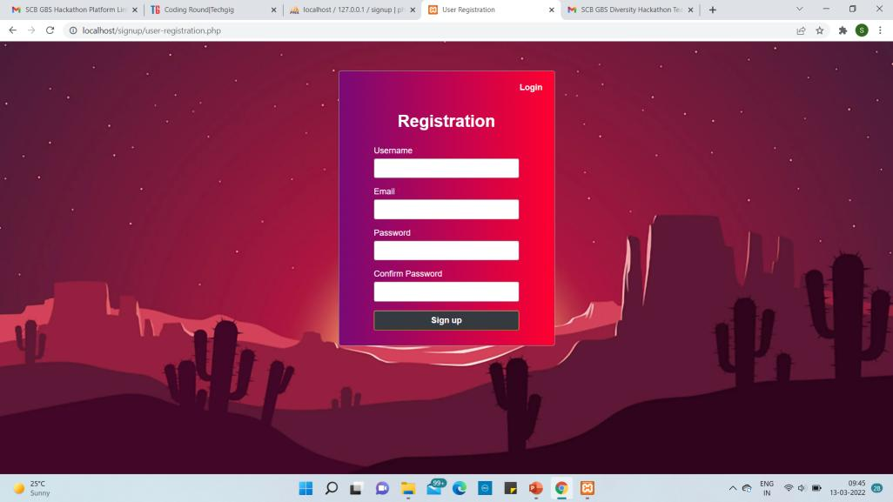
Created by Sherin

Slide 13
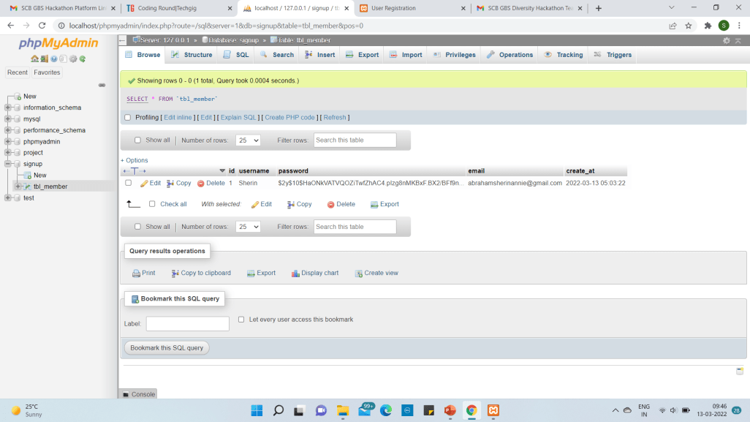
Created by Sherin

Slide 14
Neha Rajgaria
List of Contributions
Did some research on the recommendation model.
As the team leader, uploaded the required documents for the first round.
Member Details:
Contact no: 8910291453
Email: neha.rajgaria01@gmail.com

Slide 15
Akkireddy Bharani
List of Contributions
Learnt HTML and CSS and made a basic Login Page
Added the mentor/mentee dropdown
Member Details:
Contact no: 7799383538
Email: bharaniakkireddy@gmail.com

Slide 16
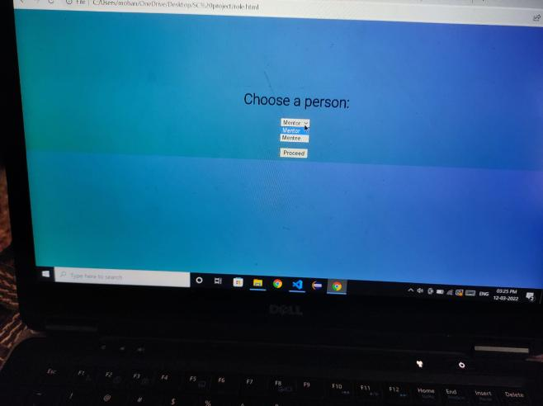
Created by Bharani

Slide 17
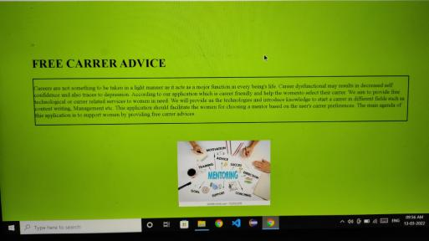
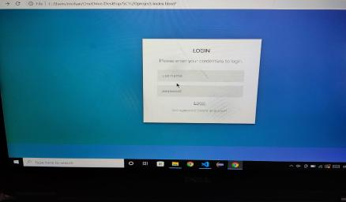
Created by Bharani

Slide 18
Brunda K
List of Contributions
Front End Work:
Complete dashboard layout including the HTML layout as well as CSS styling.
Added all the mentors profile seen in the website.
The mentors page was also designed by this individual.
Linked all the HTML pages to make an integrated front-end
Completed front-end linking
Demo Video Creation
Member Details:
Contact no: 7996138638
Email: brundakumar193@gmail.com

Slide 19
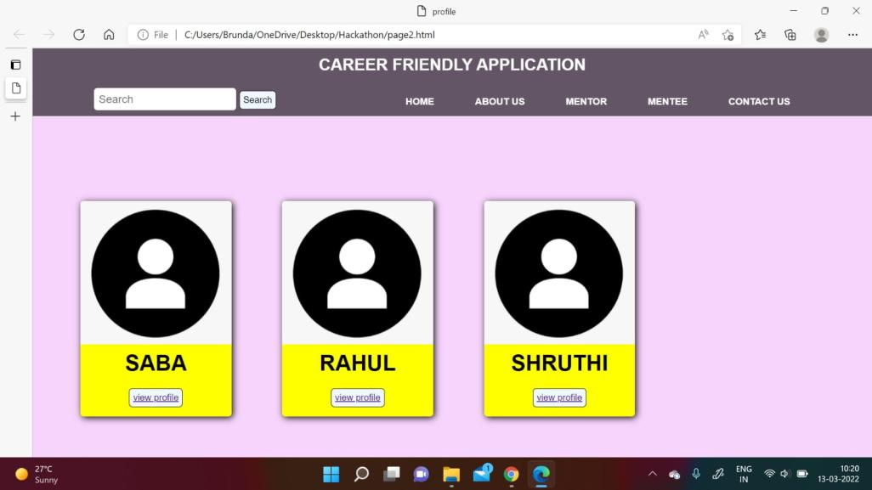
Created by Brunda

Slide 20
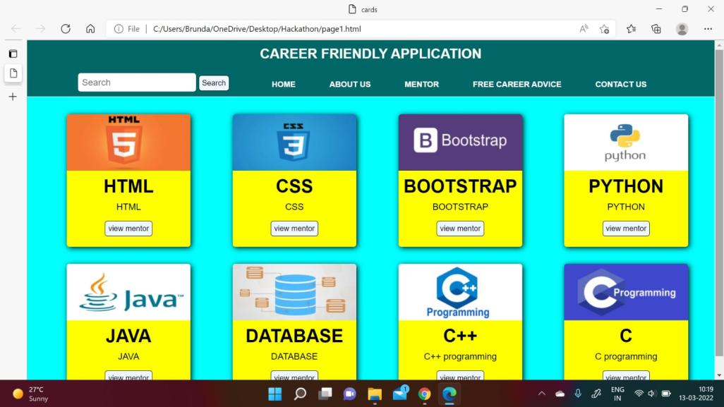
Created by Brunda

Slide 21
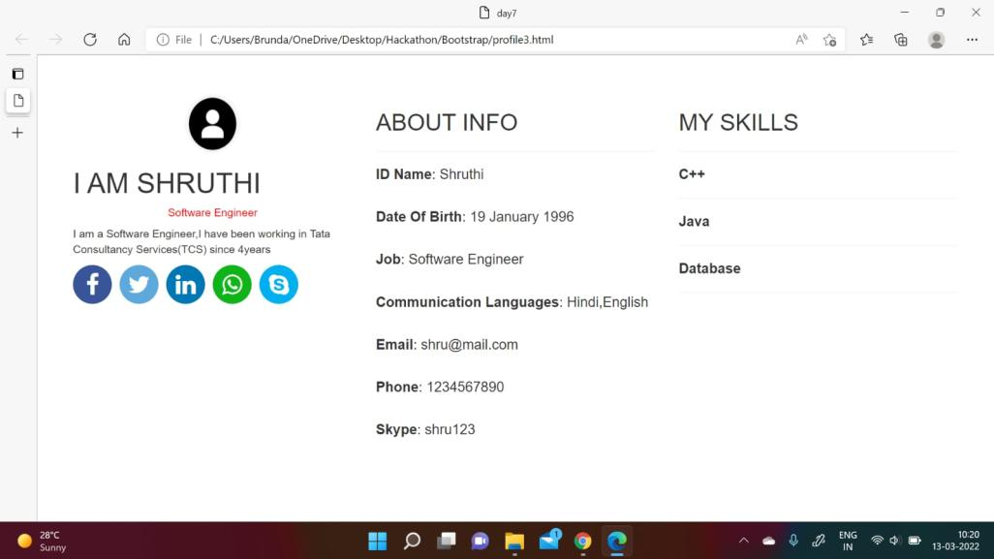
Created by Brunda

Slide 22
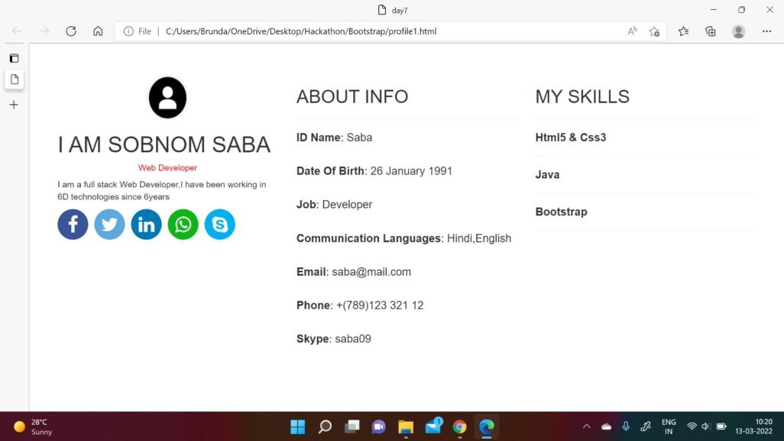
Created by Brunda

Slide 23
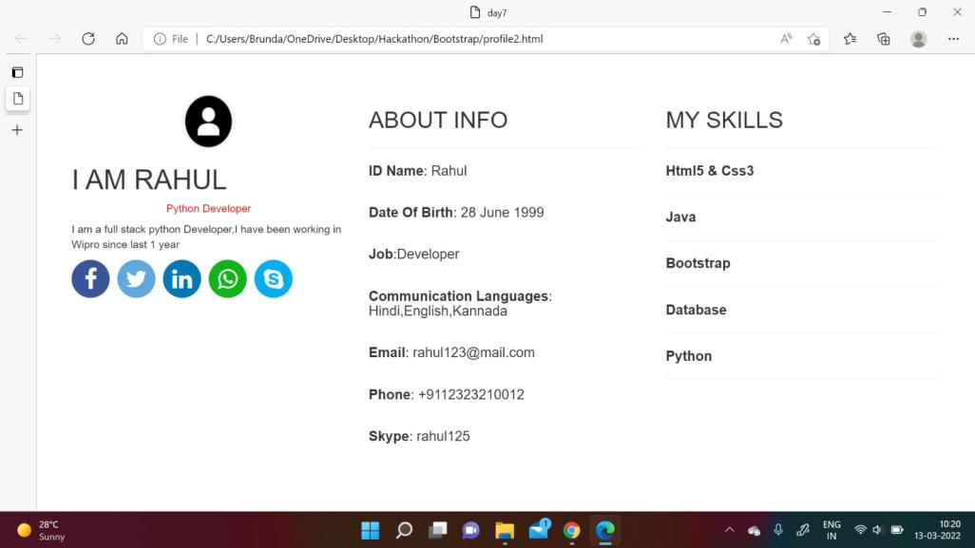
Created by Brunda

Slide 24
Muskan Jaiswal
List of Contributions
Made a considerable contribution in the front end
Completed the mentor registration form with HTML & CSS
Completed the mentee registration form with HTML & CSS
Completed the About page, and added the necessary styling
Helped in linking of all the front-end pages
Demo-video creation
Member Details:
Contact no: 9670299033
Email: muskan.18bit1053@abes.ac.in

Slide 25
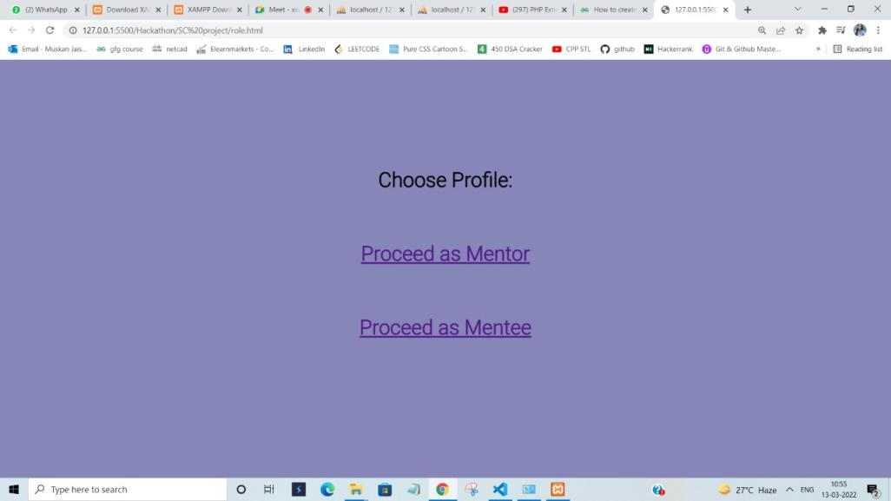
Created by Muskan

Slide 26
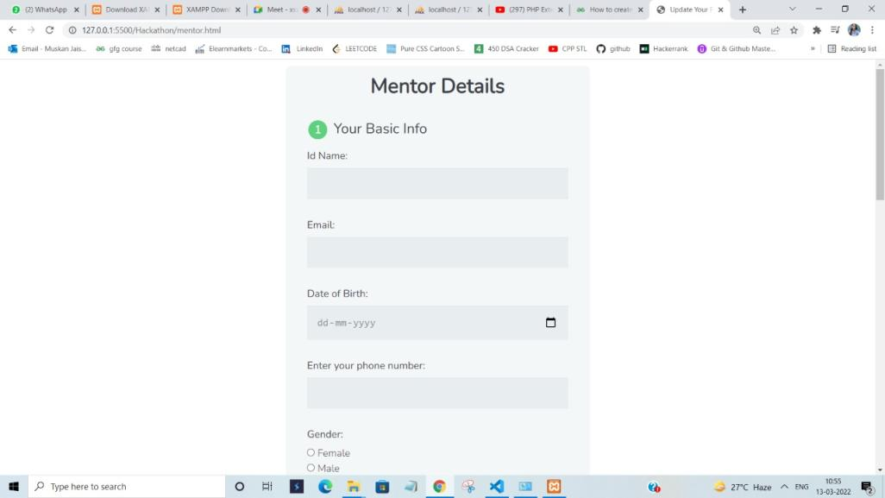
Created by Muskan

Slide 27
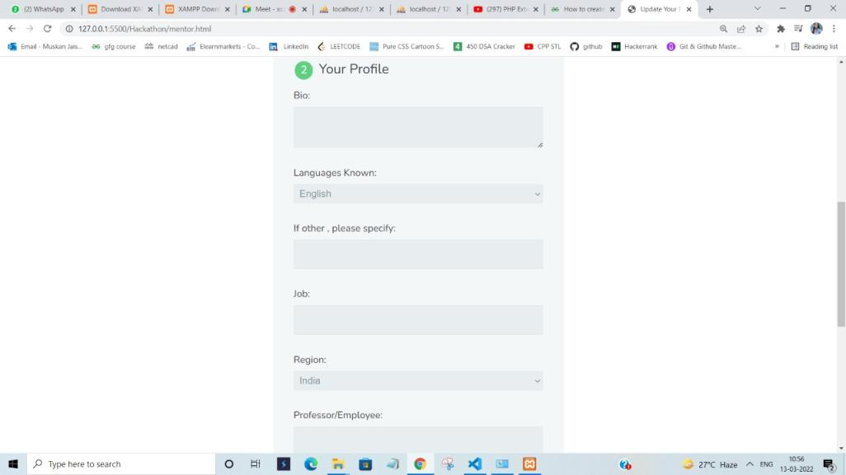
Created by Muskan

Slide 28
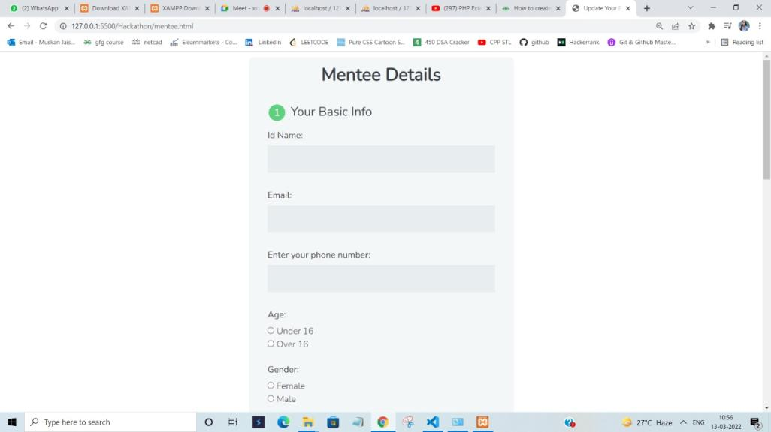
Created by Muskan

Slide 29
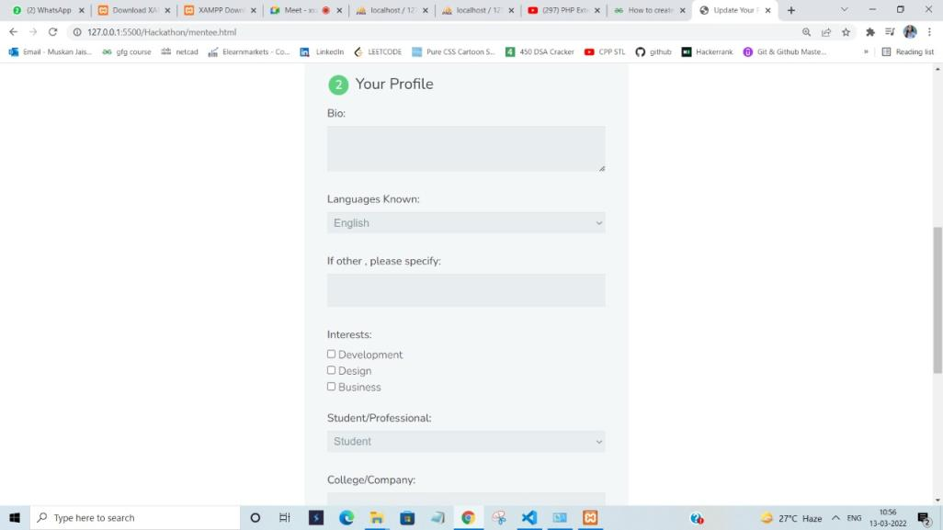
Created by Muskan

Slide 30
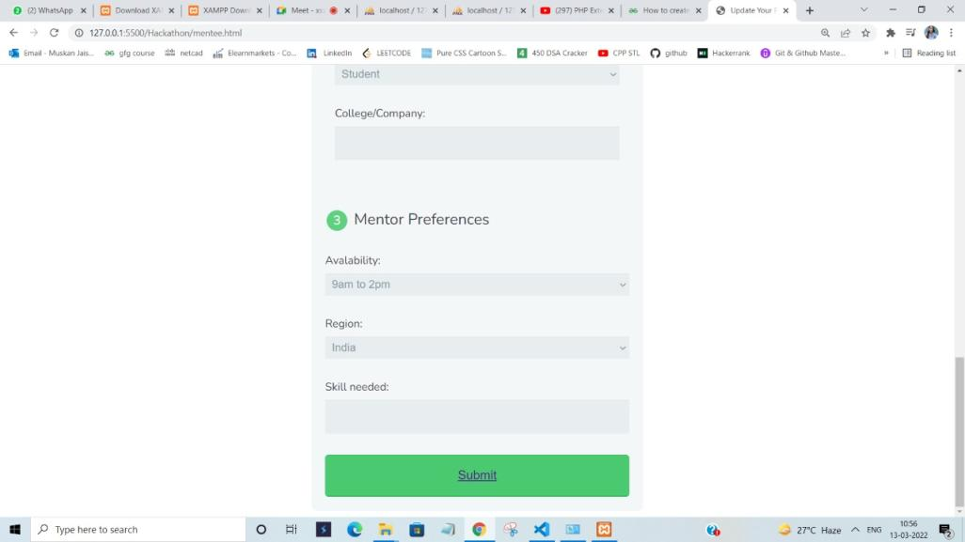
Created by Muskan

Slide 31
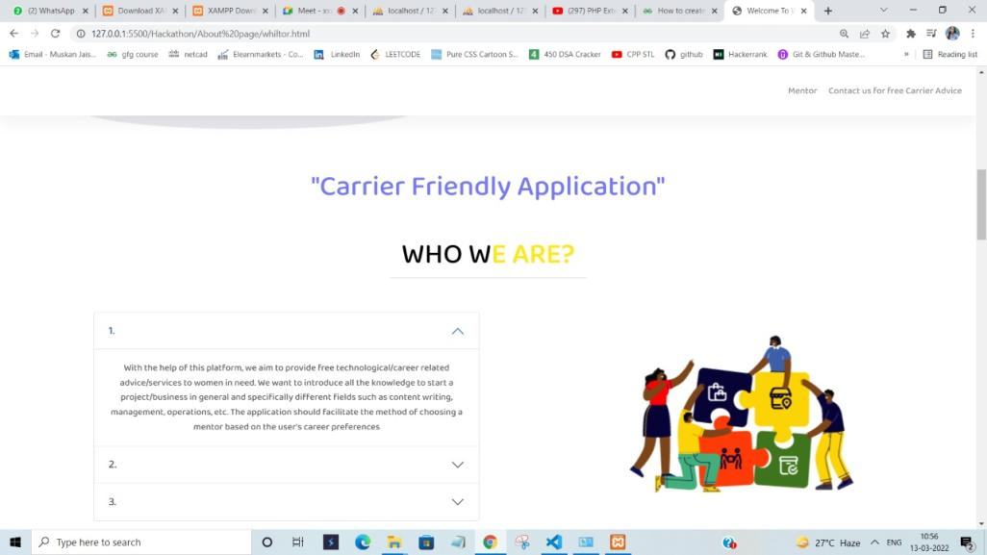
Created by Muskan

Slide 32
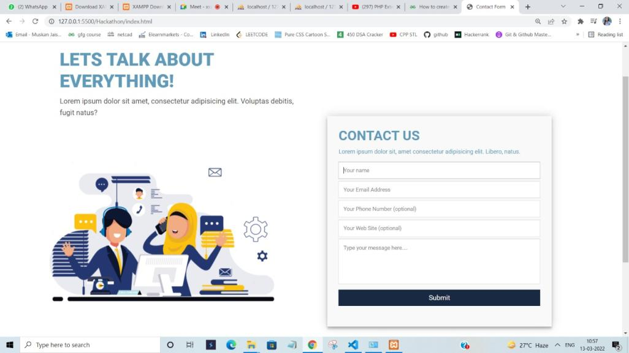
Created by Muskan

Slide 33
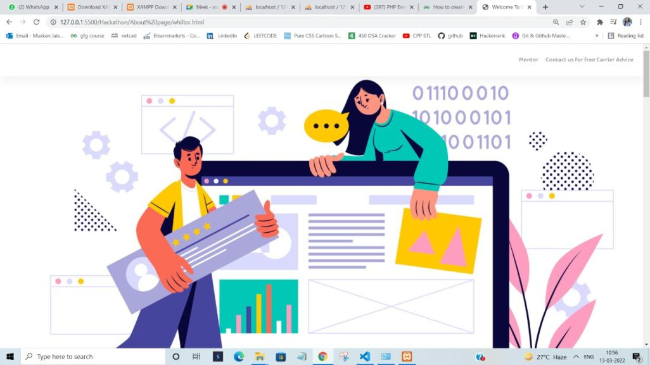
Created by Muskan

Slide 34
Hafsa Shaikh
List of Contributions
Helped in doing research work for using machine learning concepts in the project
Helped in searching appropriate content for linking an HTML page to MySql using PHP, which was extremely helpful in the creation of the backend for login/signup page
Helped in suggesting the tables required for the complete database.
Made the solution explanation in PPT
Created the GitHub Repository
Member Details:
Contact no: 9326480498
Email: shaikhhafsa25@gmail.com

Slide 35
CI/CD Pipeline
A CI/CD pipeline is a series of steps that must be performed in order to deliver a new version of software
Introduces monitoring and automation to improve the process of application development, particularly at the integration and testing phases, as well as during delivery and deployment
Elements of the pipeline include: Build, Test, Release, Deploy, Validation and compliance
Written by Sherin

Slide 36
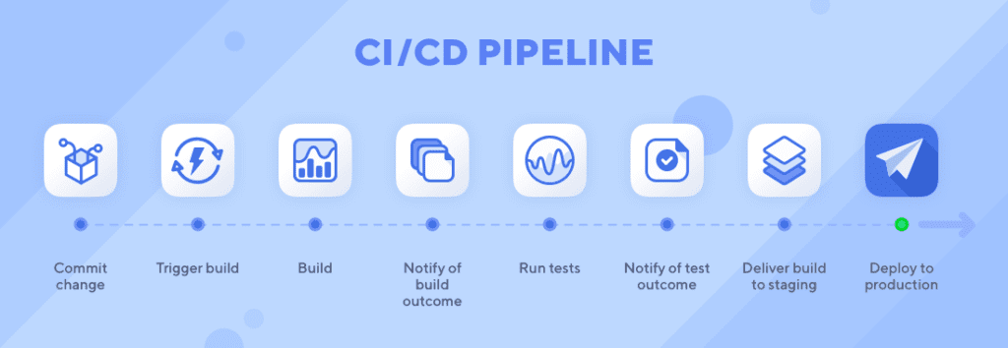
Image from Google

Slide 37
Continuous Integration
CI is an automation process for developers. It is used to make sure that any changes to the code is built, tested and merged to a shared repository.
It makes sure that no conflict occurs.
The main goal here is to have multiple developers working simultaneously on separate features, of the same application.
Continuous integration (CI) helps developers merge their code changes back to a shared branch, or “trunk,” more frequently—sometimes even daily. Once a developer’s changes to an application are merged, those changes are validated by automatically building the application and running different levels of automated testing, typically unit and integration tests, to ensure the changes haven’t broken the app.
Written by Sherin

Slide 38
Continuous Delivery
Following the automation of build, test and merge/integration testing in CI, continuous delivery automates the release of that validated code to a repository
The compulsory requirement for this is that a CI is already built into the development pipeline.
Written by Sherin

Slide 39
Continuous Deployment
This is the final stage of a CI/CD pipeline.
It picks up where continuous delivery left off.
It’s function is to automatically deploy to production
Because there is no manual gate at the stage of the pipeline before production, continuous deployment relies heavily on well-designed test automation.
Written by Sherin

Slide 40
Future Scope
The website is created according to the problem statement provided to the team, but we have also planned to extend this project with the following concept:
Create an exclusive dataset
Creation of a recommendation system
Written by Sherin
Idea contribution: Hafsa, Sherin, Muskan, Neha

Slide 41
Recommendation System
This system is basically a type of data filtering tool which recommends/displays the most relevant items according to the user data available.
The most common example of the use of this system is Netflix. It presents viewers with movie and or TV show suggestions.
Amazon uses the recommendation system to provide customers with new products.
Written by Sherin
Idea contribution: Hafsa, Sherin, Muskan, Neha

Slide 42
Proposed System
In the proposed website the mentee would be able to see suggestions generated from the common skill set and preferences that the mentee and mentor share.
This will help the mentee to connect with the correct mentor according to her preference, without having to spend too much time on it.
This system will enhance user experience as well as make surfing the website much easier and less time consuming.
Written by Sherin
Idea contribution: Hafsa, Sherin, Muskan, Neha

Slide 43
Conclusion
The project is made in accordance with the problem statement

